Slide 1

Exercise Work Presentation
Student:
Tuong Hoang
Secure Programming
Secure Programming

Slide 2
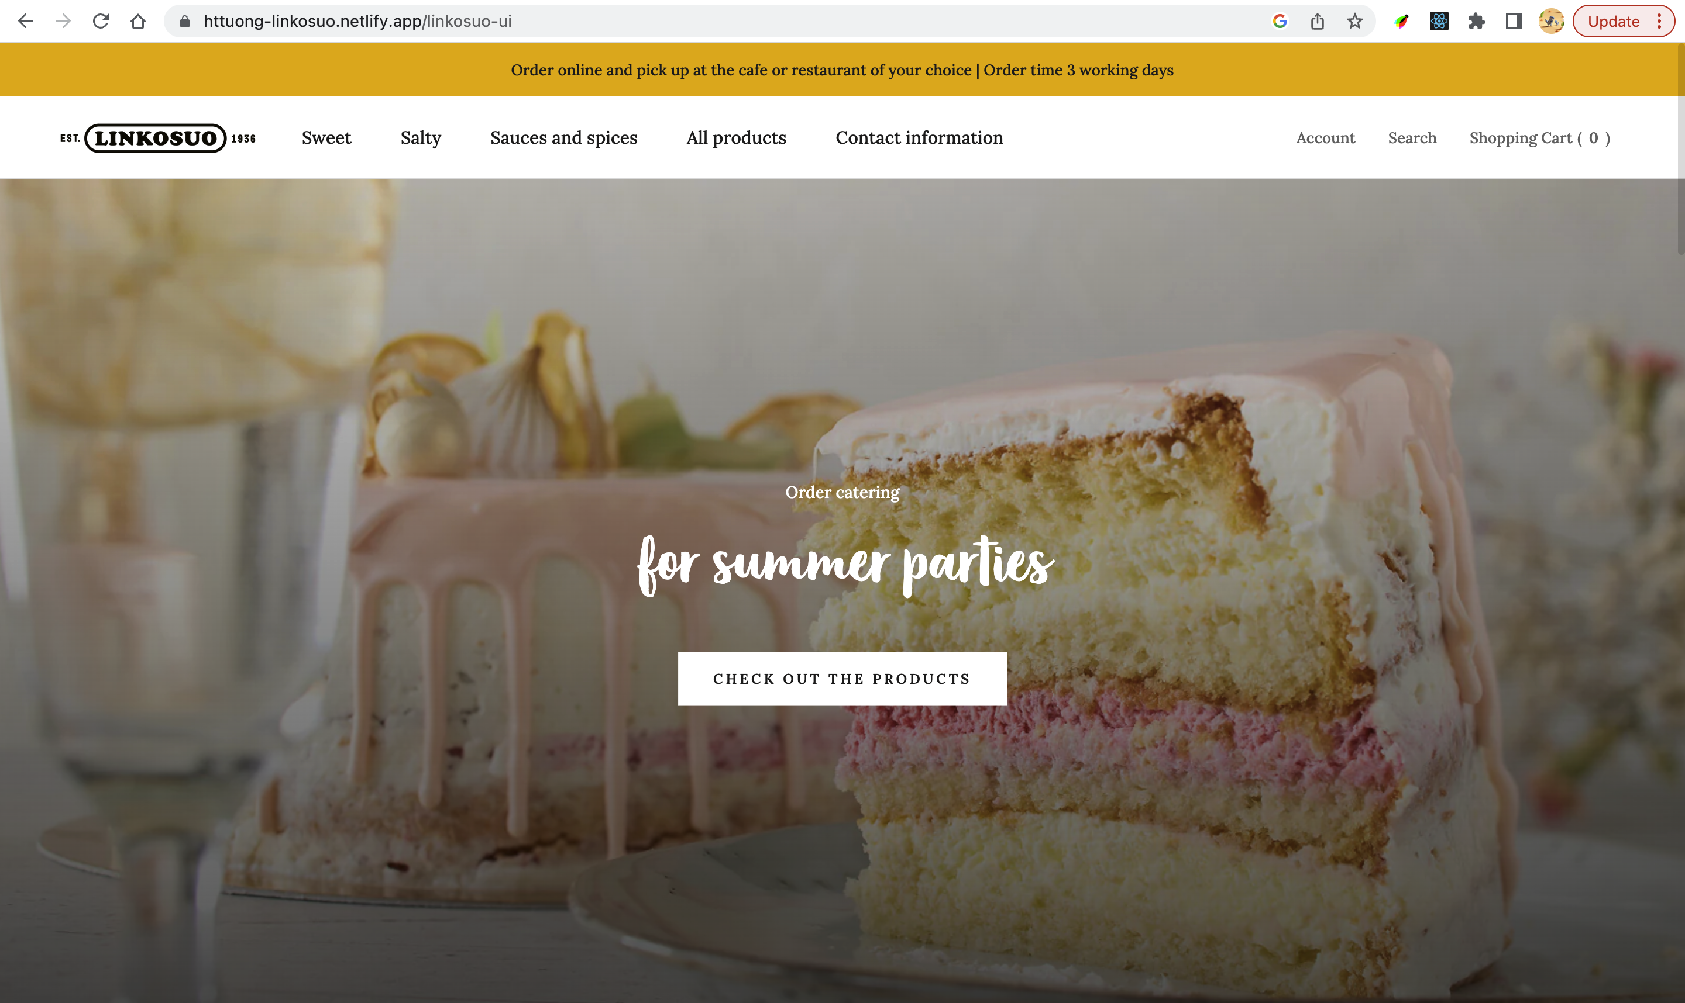
INTRODUCTION
This is an old MERN project that I had built in the summer to practice my web development skills and I have been updating some new secure functionalities to it.
The website allows customers to see the detail and pre-order dishes, create an account and log in to see all the orders in the past.
Secure Programming

Slide 3
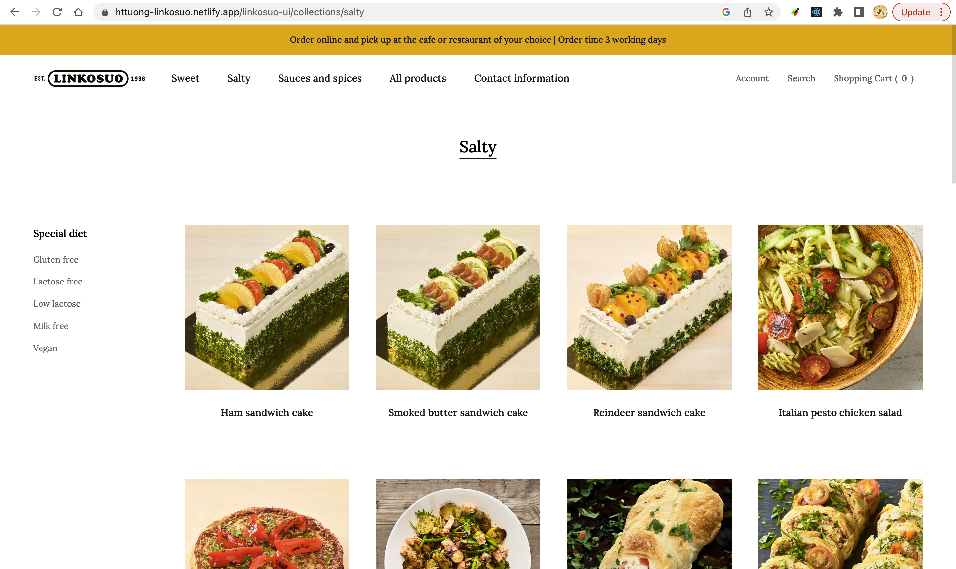
FEATURES
Routing
The below picture is the user interface of homepage. From this main page, user can navigate through other pages to explore many kinds of products and dishes such as sweets, sauces and so on by selecting titles in the white header.
Secure Programming

Slide 4
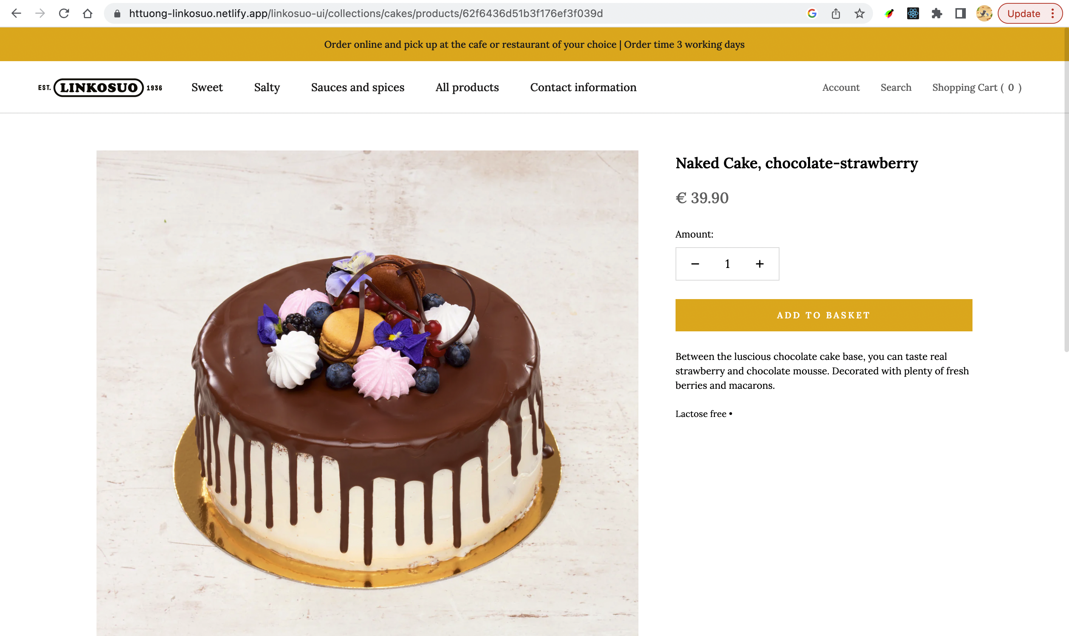
Add product to cart.
User can inspect the detail of certain dishes or products by clicking on the products’ image card. This will lead users to the detail page where expose all the information of that product.
Secure Programming

Slide 5
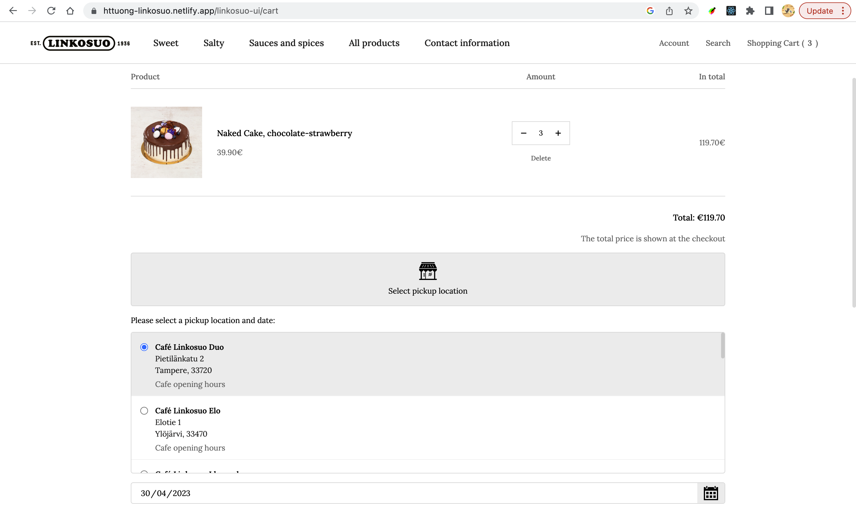
Make an order.
Users can also see all the added products in the shopping cart. In this page, the number of products can still be modified or deleted conveniently. The pickup location and date have to be chosen so that the restaurant can know where and when users come.
Secure Programming

Slide 6
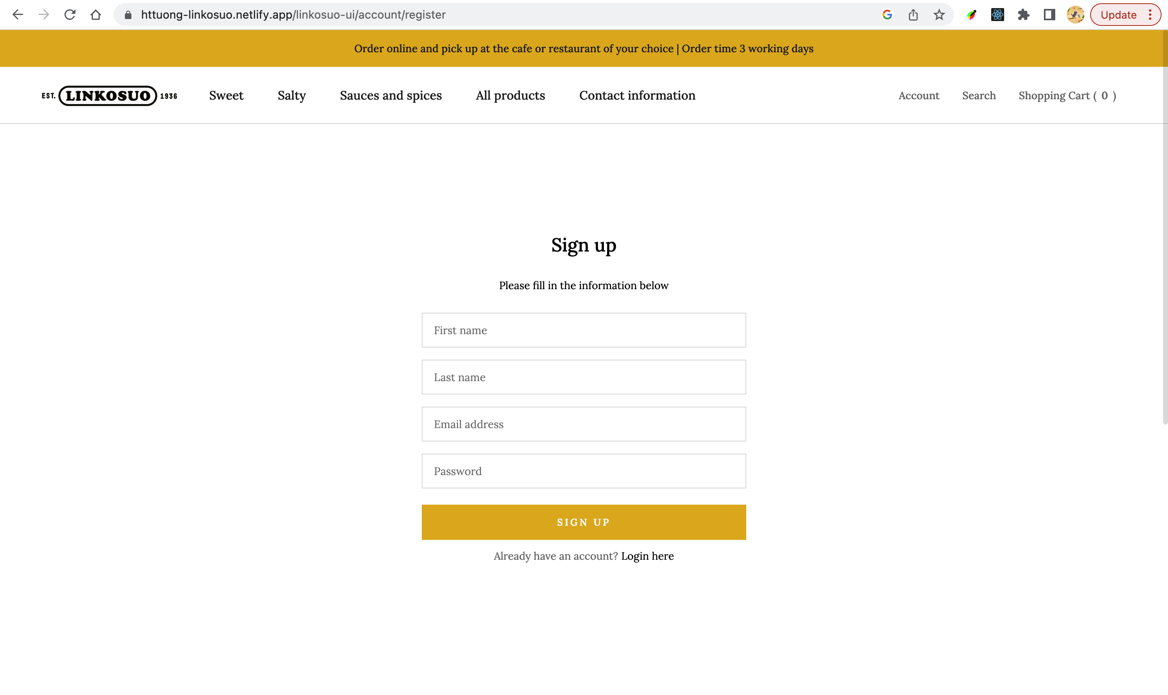
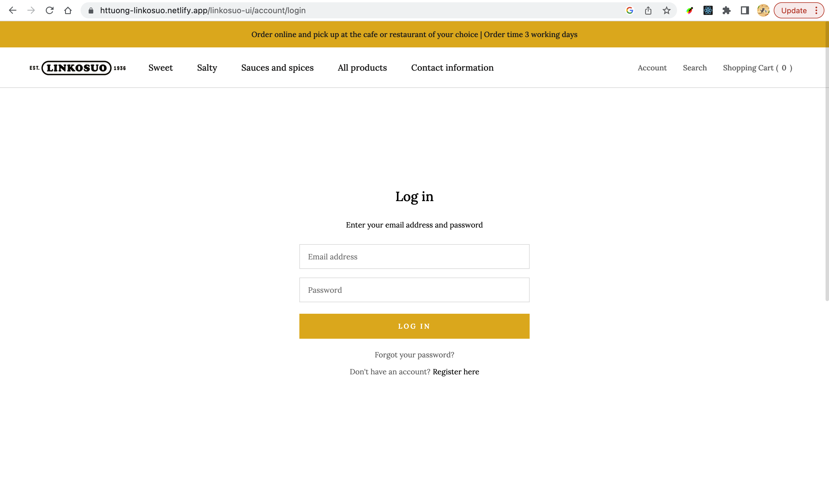
Authentication
Users can create the account for their own usage with email address and password. They can also change the password as desired when forgetting it.
Secure Programming

Slide 7
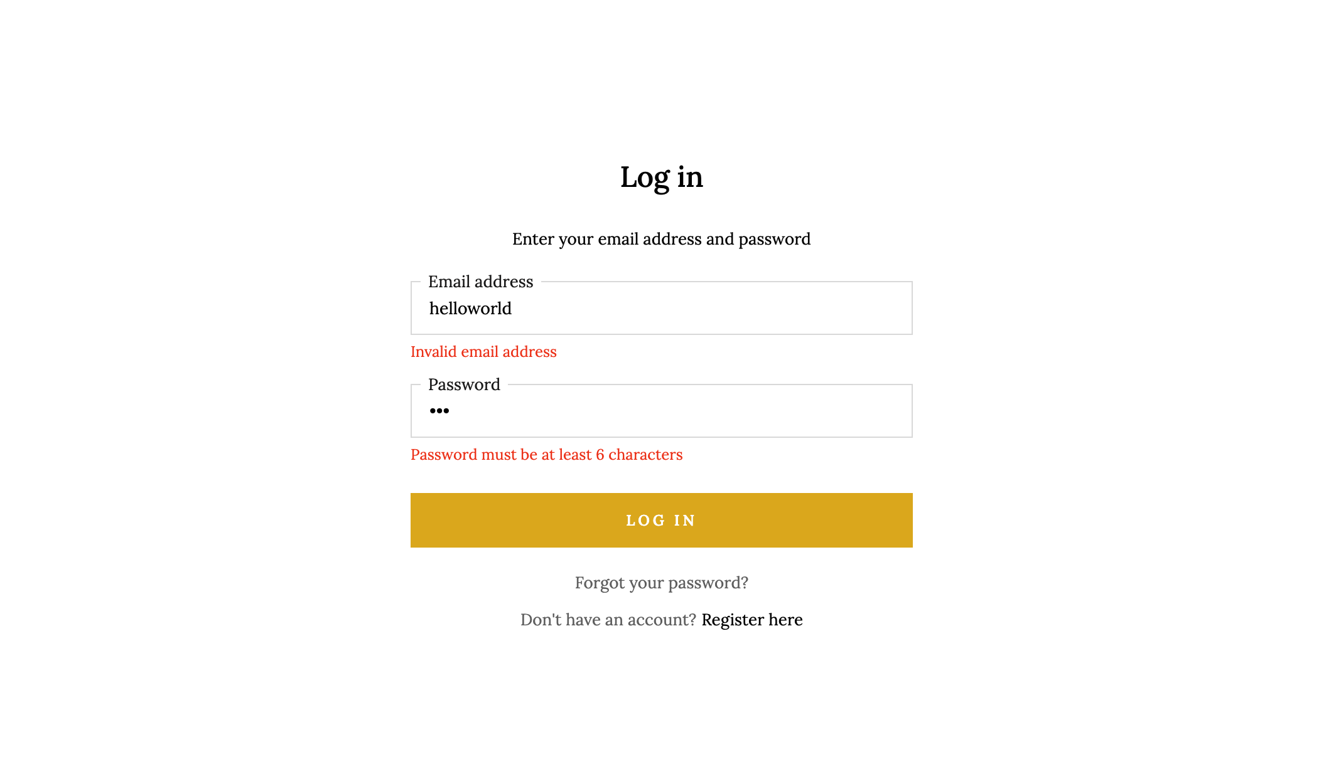
SECURITY SOLUTIONS
Input validation
In Login and Signup form, each specific input field will have a regex function to validate the typed value. This enhances the security of the form when users submit their value to server and reduce the rate of XSS attack.
Secure Programming

Slide 8
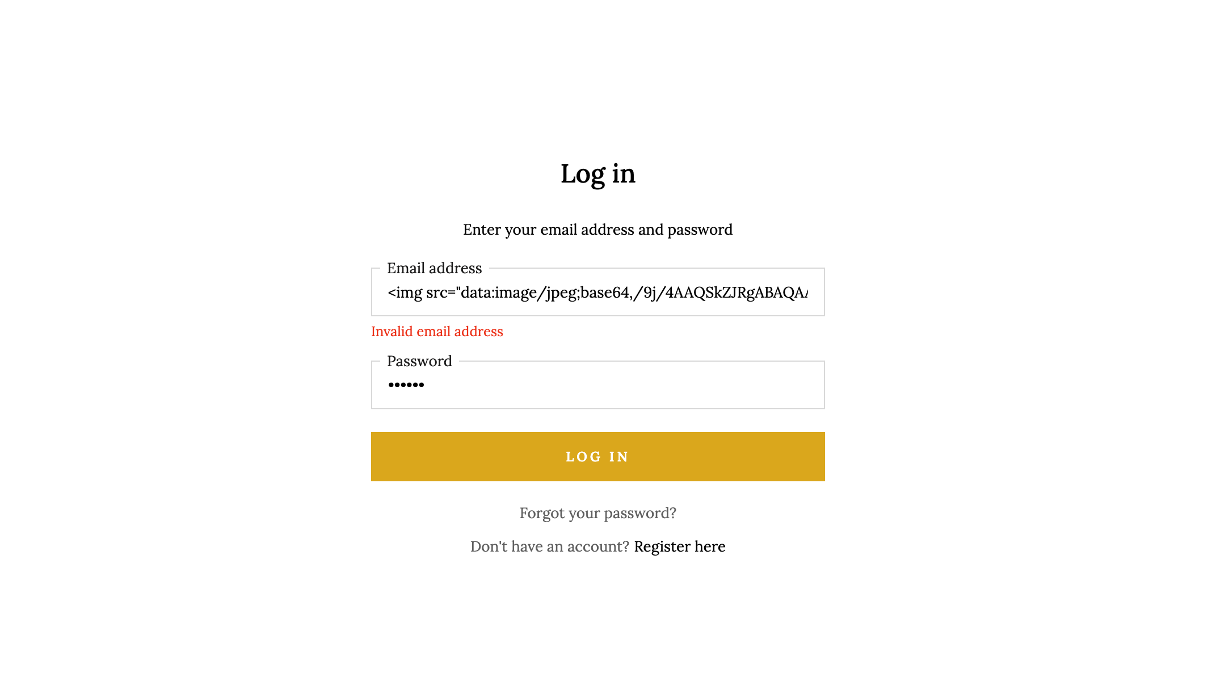
Input sanitization
Thank to email regex, invalid value in email field will not be submitted to server although an image tag is passed into the field.
And by default, React DOM automatically escapes any value embedded in JSX before rendering them
Secure Programming

Slide 9
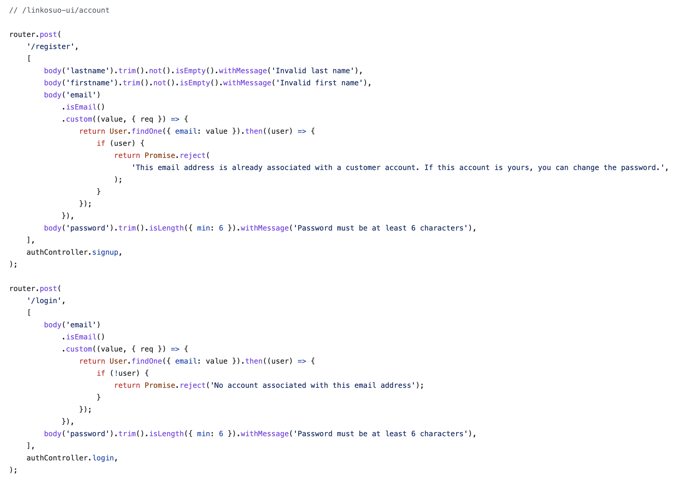
Server input’s validation
For every incoming request, server will check the value in body with the same logic in the front-end side. This is the second security layer and a safe mechanism to make sure that the data is all valid before saving in the database.
Secure Programming

Slide 10
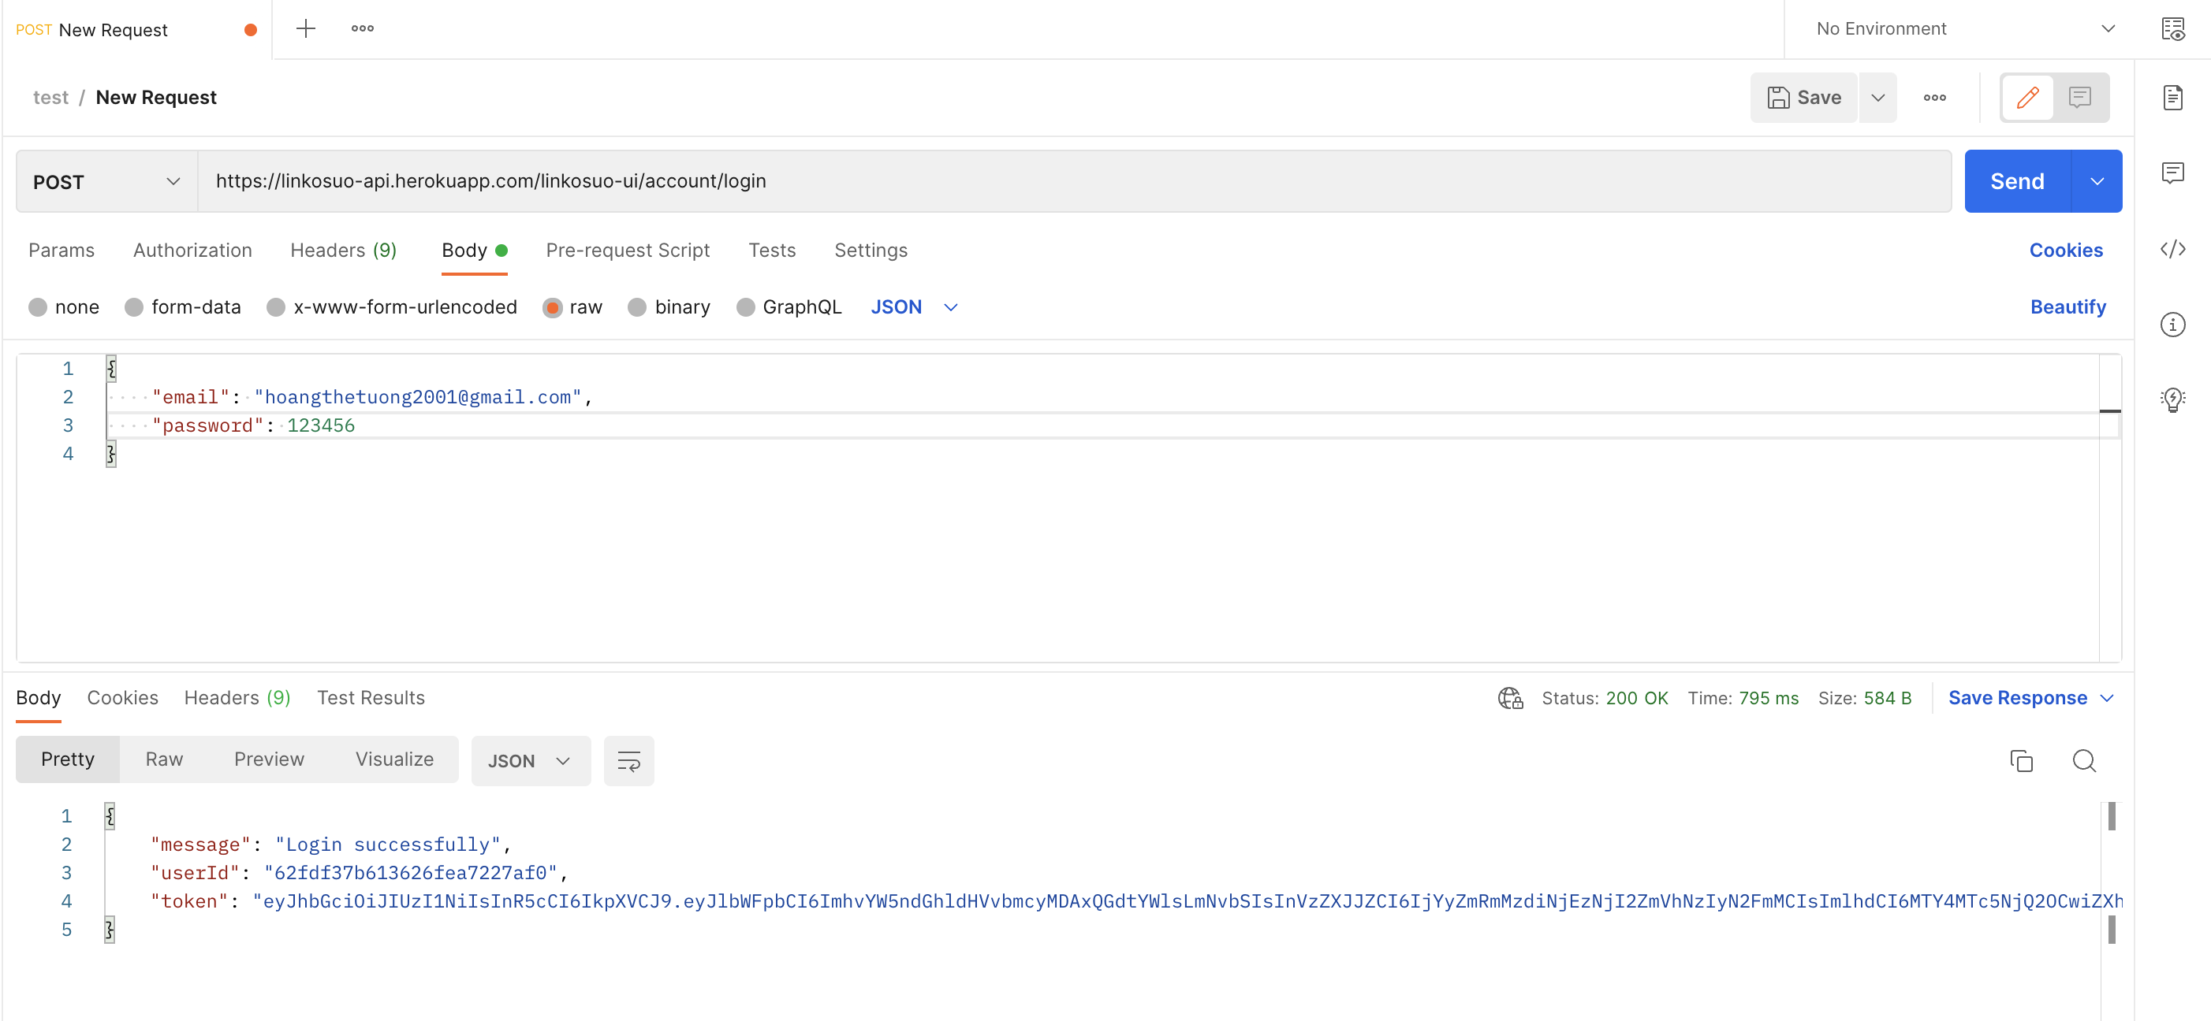
This is a typical submission of valid values.
Secure Programming

Slide 11
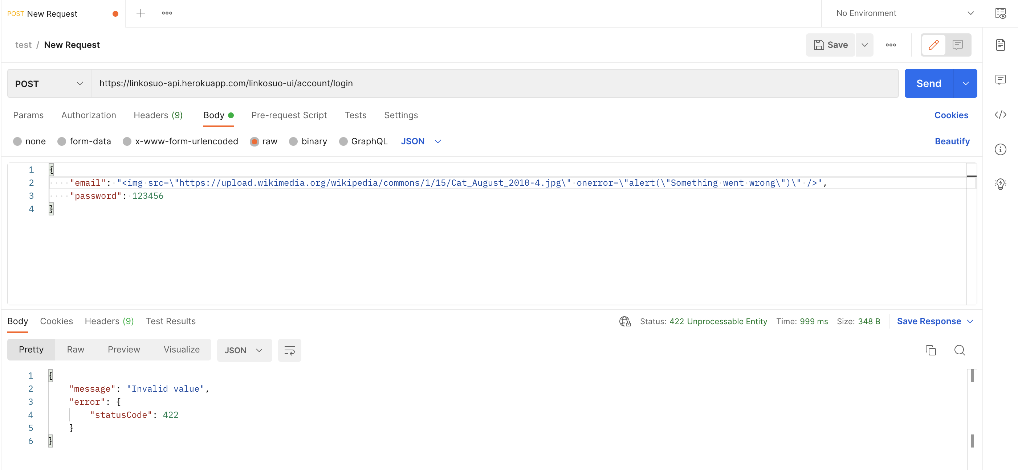
If I try to submit the above value without FE validation, the server can detect the invalid value and send the error response.
Secure Programming

Slide 12
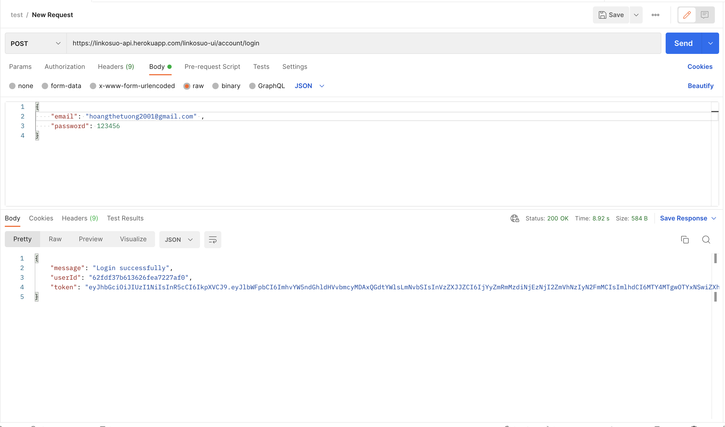
Authorization and JWT
Some of routes and APIs are only available for authenticated user because of JWT. Each incoming request with data to the server will trigger a new JSON web token’s generation. This token will be sent back to client for the next request’s usage.
Secure Programming

Slide 13

SECURITY VULNERABILITIES
1. The leak of password can lead to the unauthorized access to account.
2. If the JSON web token is somehow stolen, it can be attached and sent to server to modify user’s information.
Secure Programming

Slide 14
REFERENCES
Github: https://github.com/HTTuong/Secure-Programming
Netlify: https://app.netlify.com/
Heroku: https://www.heroku.com/
Linkosuo: https://kauppa.linkosuo.fi/
Secure Programming

Slide 15
Thank you for listening !
Secure Programming

